Slide 1
VE458
Biomedical Instrumentation and Design
Final Project Proposal
Alternative communication with single-muscle EMG
Group 7
Lu Xiuneng Lin Junwei
Wang Yuxuan Tommaso Cemmi
2017/11/27

Slide 2
Index
01. Diagram of Our System
02. Components & Costs
03. Hardware Part
04. Software Part
05. Demo & Results
06. Suggestions & Conclusions
07. Q & A

Slide 3
Amyotrophic Lateral Sclerosis (ALS)
Lu xiuneng
A disease that causes the death of neurons which control voluntary muscles
30%
Muscles
Decreasing in
Size
01
02
Stiff Muscles
04
Difficulty in
Speaking,
Swallowing
03
Difficulty in
Breathing

Slide 4
Aim
Lu xiuneng
To help those without limbs, cannot speak but at least one of his muscle are active to communicate with others.

Slide 5
01
Diagram of Our System
Lu Xiuneng

Slide 6
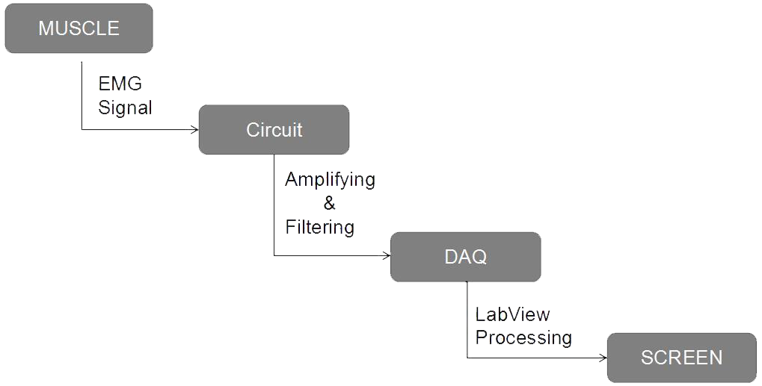
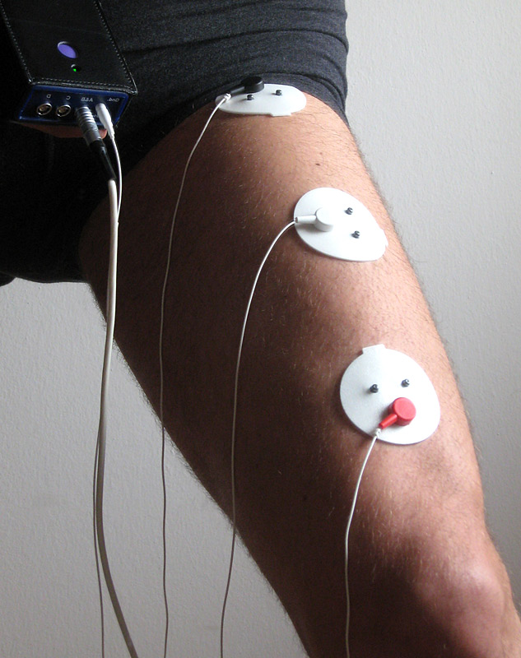
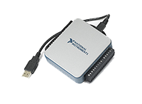
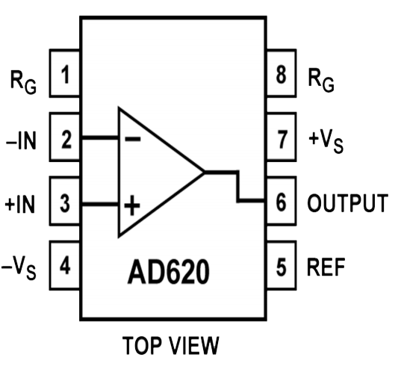

Design - Overview
Lu Xiuneng
http://vibrationtrainingdevice.com/VG-Evolution/emg-elettrodi-b.jpg
http://sine.ni.com/images/products/us/04231404_m.jpg
https://s3.amazonaws.com/siteninja/multitenant/images/6912/images/slide/Screen-hand-540x300_1_.jpg_1266619279?1340887223

Slide 7
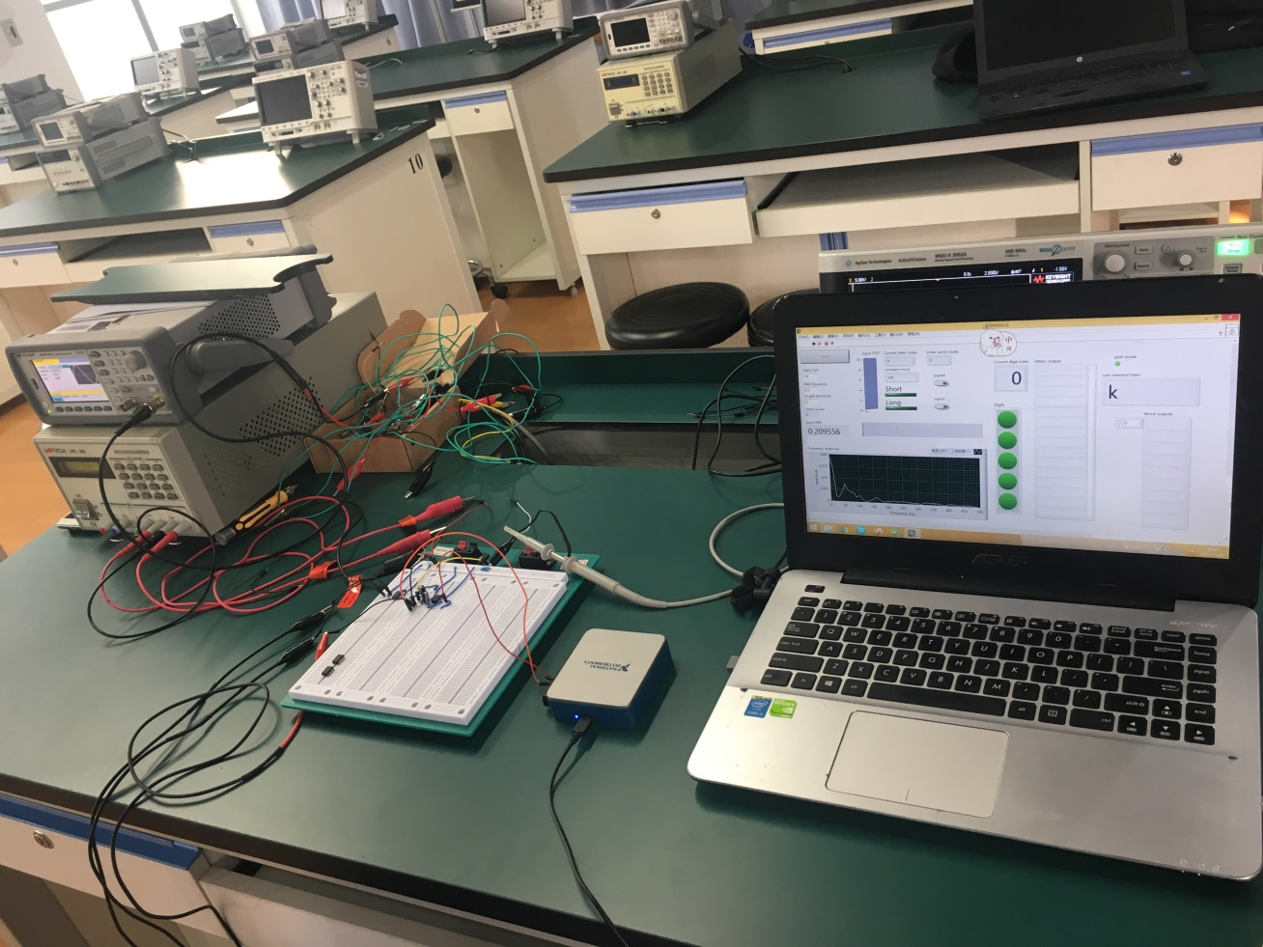
A Real Image
Lu Xiuneng

Slide 8
02
Components & Costs
Lu Xiuneng

Slide 9
Components & Costs
Lu Xiuneng
Components | Quantity | Cost per unit (CNY) | Cost (CNY)
AD620 Amp | 1 | 7.8 | 7.80
LM741 Amp | 1 | 2.5 | 2.50
Wires | 1.5m | 1.18/m | 1.77
Capacitors | 2 | 0.75 | 1.50
Resistors | 4 | 0.44 | 1.76
DAQ board | 1 | 3048 | School Provided
Total |  |  | 15.33

Slide 10
03
Hardware Part
Lu Xiuneng

Slide 11
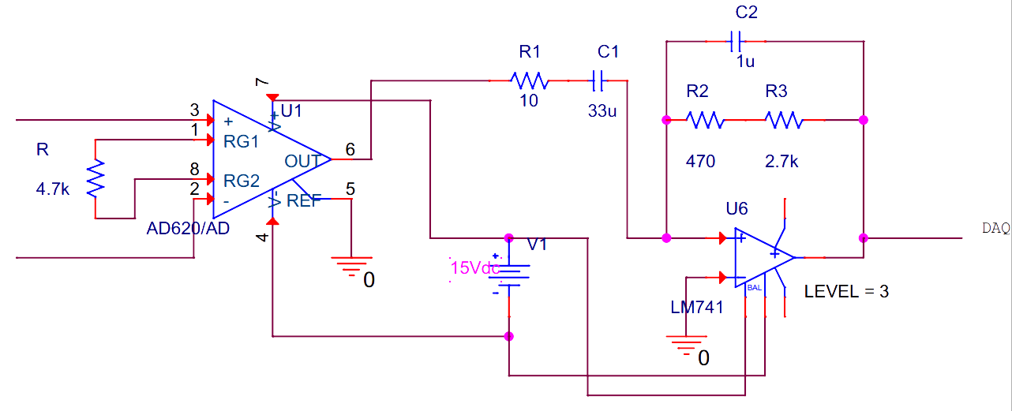
Functions & Schemetics
Lu Xiuneng
Functions: Get the EMG signal, amplify it and filter the noise.
Expected gain: ~300
Expected Cutoff frequency: 50 Hz & 450 Hz
Schemetics:

Slide 12
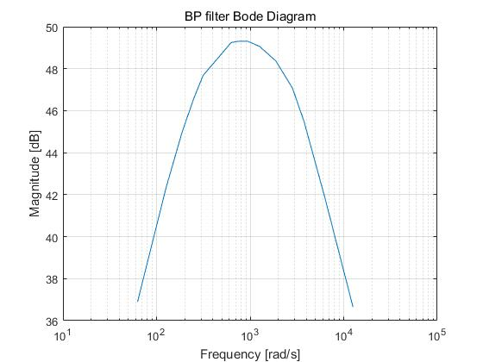
Test Results for Hardware
Lu Xiuneng
We let Vin = 50mVpp, and here is the results:
Frequency (Hz) Vout (V) Gain
10 3.50 70.0
20 6.51 130.2
30 8.9 178
40 10.7 214
50 12.1 242
100 14.5 290
120 14.6 292
150 14.6 292
200 14.2 284
300 13.1 262
450 11.3 226
600 9.4 188
1000 6.2 124
2000 3.4 68
Actual Gain: 290; Cutoff frequency: 35Hz and 480Hz

Slide 13
04
Software Part
Lin Junwei & Wang Yuxuan

Slide 14
Functions of Software Part
Lin Junwei
Encode instructions
Long signal represent 1, short represent 0
Execute instructions
Different modes & instructions
Display the results

Slide 15
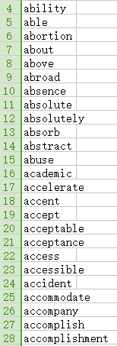
Common Word list
Lin Junwei
A wordlist with 4300+ most common used words
When first several alphabet are input, the suggest word will appear

Slide 16
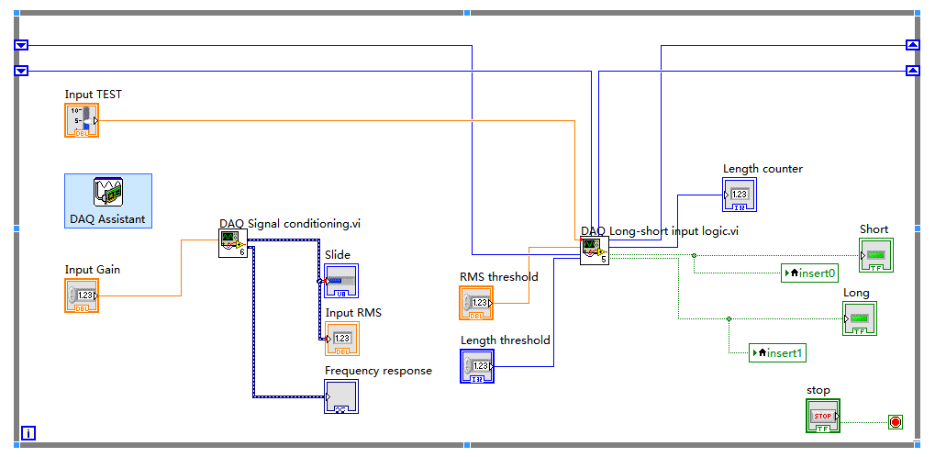
LabVIEW Block diagram (II)
Lin Junwei
EMG Signal Acquiring & Decoding

Slide 17
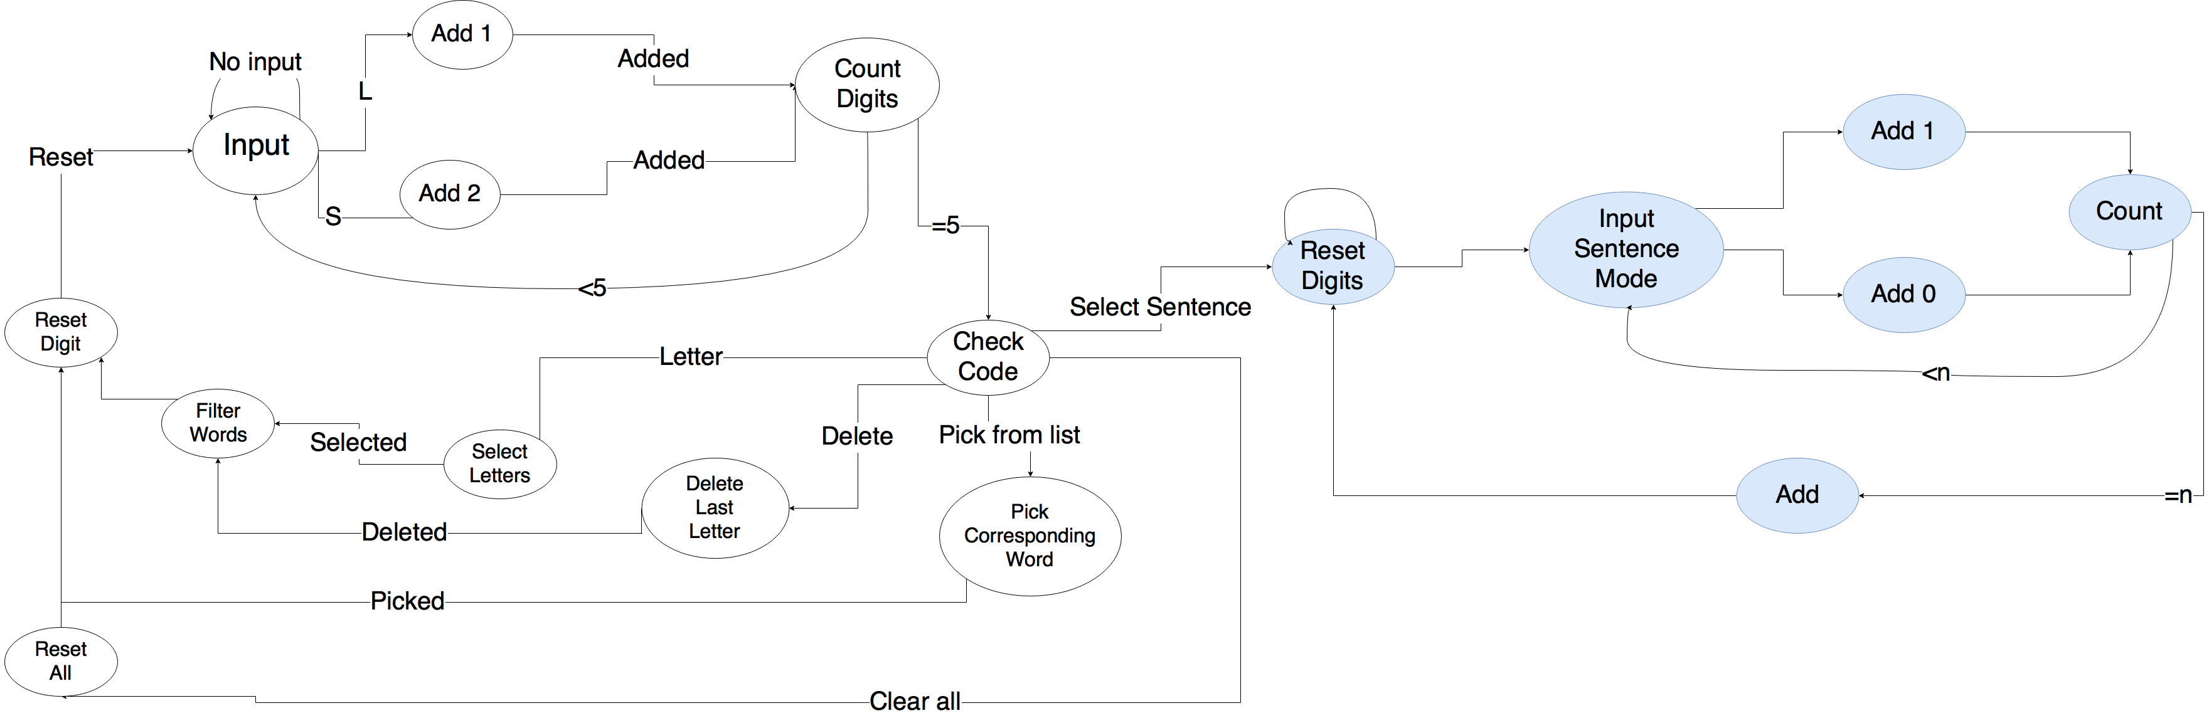
Finite State Machine
Wang Yuxuan

Slide 18
LabVIEW Block diagram (III) -- FSM
Wang Yuxuan
Input Signal
Count/Reset Digit
Add digit 1/0
Select/Delete/Enter/Pick word
Check Code/Count digit for word
Enter sentence 1/2
Clear All/Sentence
Check Code
Exit
LabView FSM Stages

Slide 19
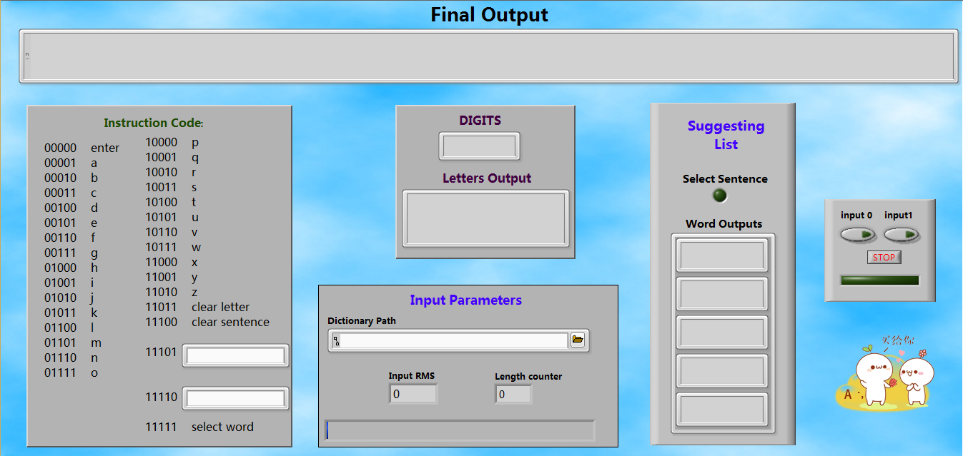
LabVIEW Front Panel
Wang Yuxuan
17

Slide 20
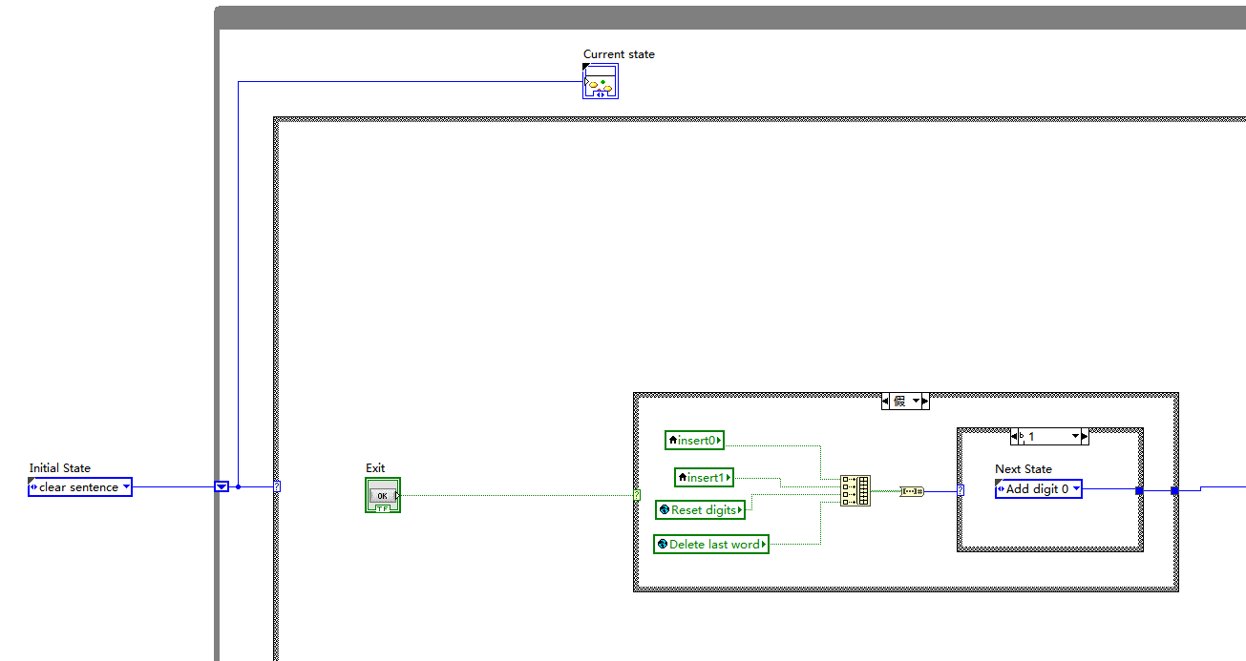
Input Signal
Wang Yuxuan

Slide 21
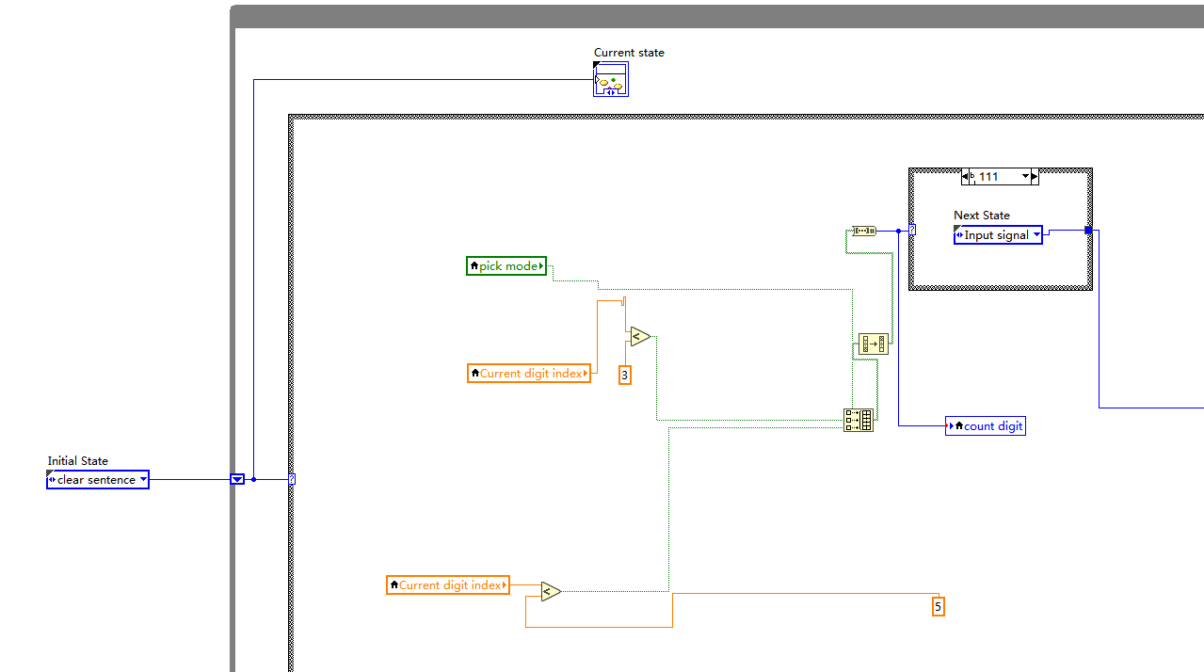
Count Digit
Wang Yuxuan

Slide 22
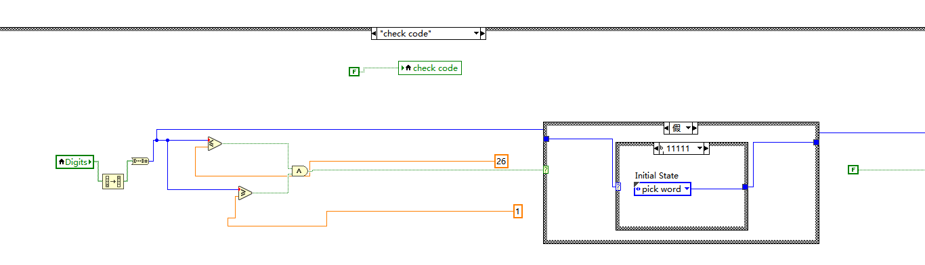
Check Code
Wang Yuxuan

Slide 23
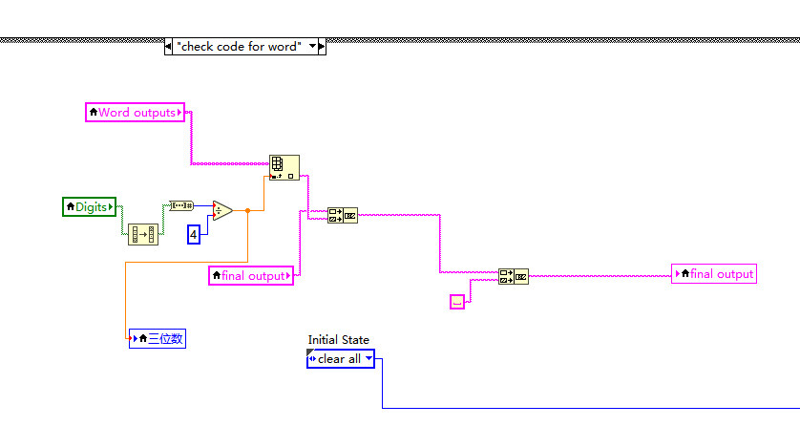
Check Code for Word
Wang Yuxuan

Slide 24
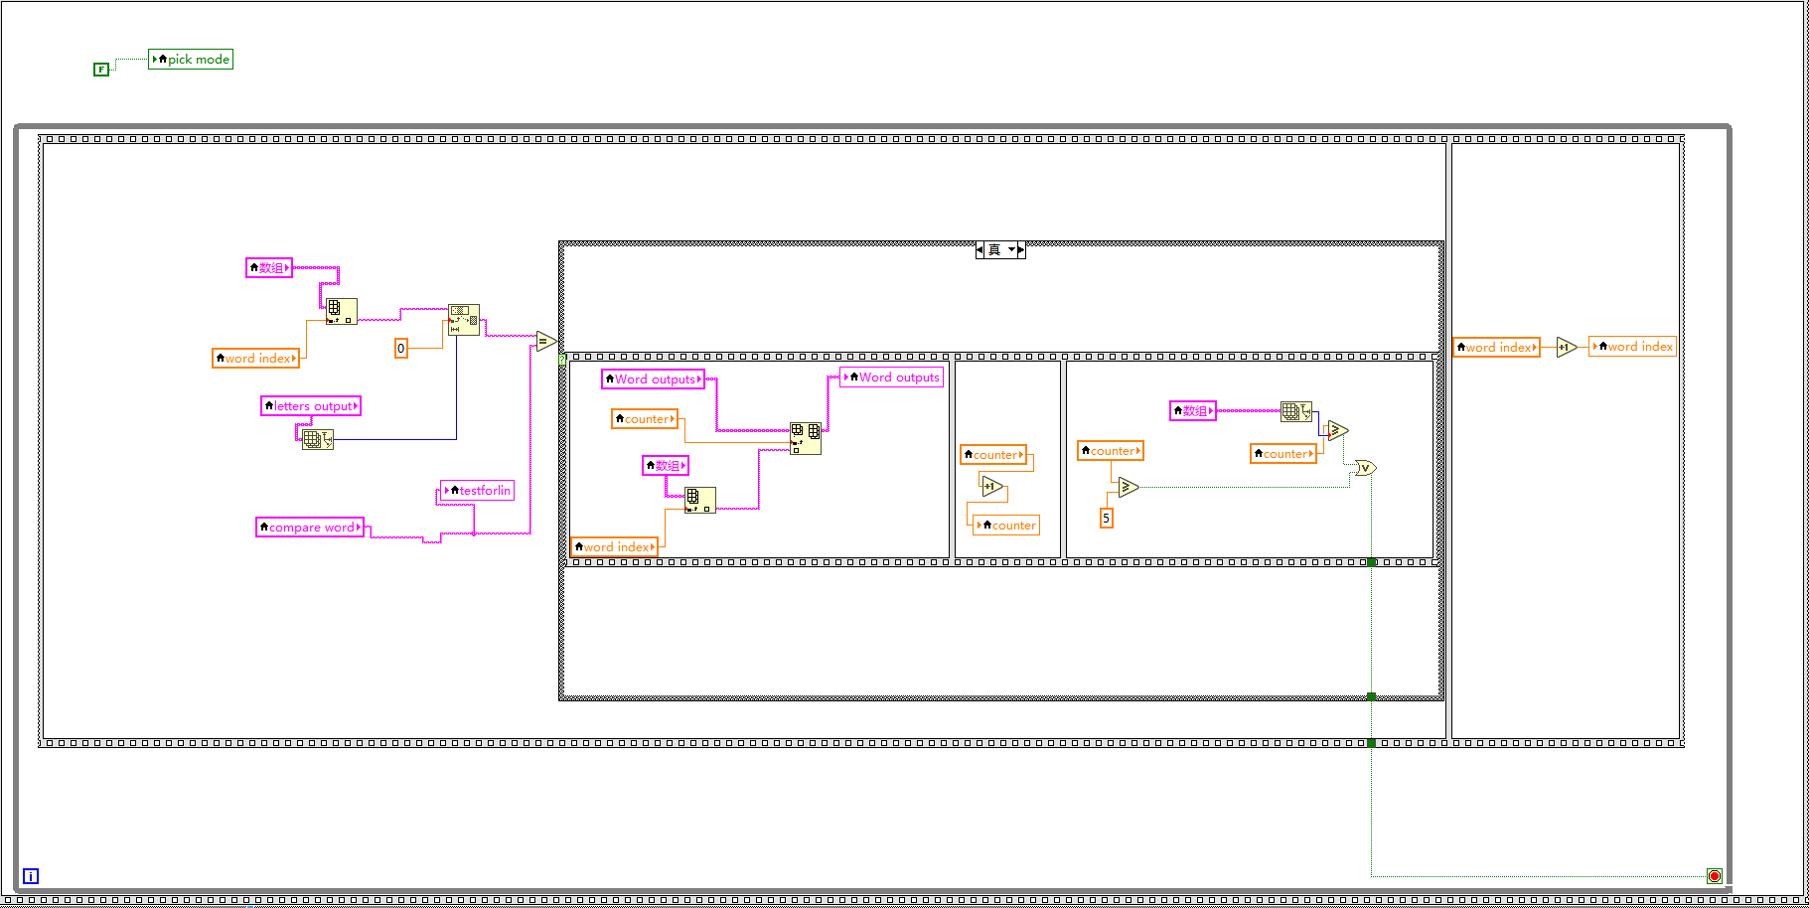
Word filter
Wang Yuxuan

Slide 25
06
Demo & Results
Tommaso Cemmi

Slide 26





Expected Result
Tommaso Cemmi
Able to input letters
Communicate any
message
No limited list of words
Able to delete wrong
inputs
Optimize input method
Suggesting words that
can be selected
Selecting common
sentences from a
list of options
Show sentence on the
screen

Slide 27
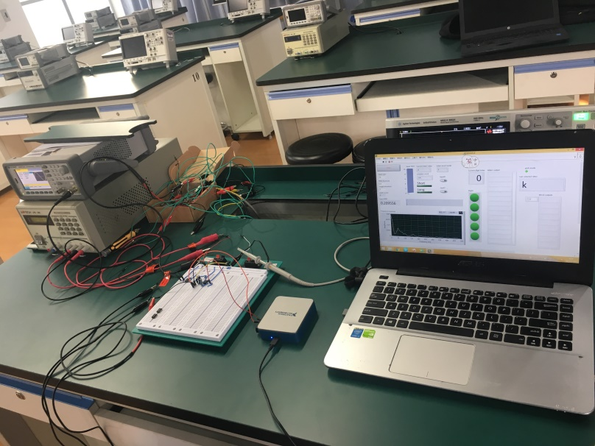
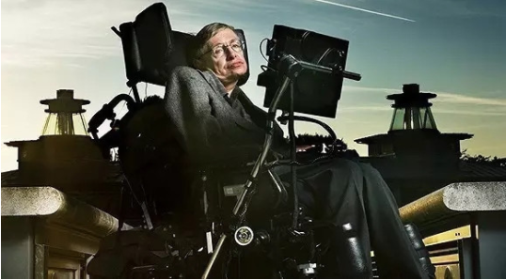
A Huge Advantage
Tommaso Cemmi
Hawking's wheel
Our design
Costs: $950,00 - $ 1,000,000
Costs: ~$2.4
http://baijiahao.baidu.com/s?id=1563218123737396&wfr=spider&for=pc

Slide 28
06
Suggestions & Conclusions
Tommaso Cemmi

Slide 29
Further Improvement
Tommaso Cemmi
Use more sensitive filters
Enlarge the dictionary
Optimize the searching algorithm
Add annother mode to enter sentence by the first alphabet
of each word

Slide 30



Conclusions
Tommaso Cemmi
VALUE
VALUE
VALUE
VALUE
01
02
03
05
Support input
complicated
word or sentence
Support input
complicated
word or sentence
Able to fast
output common
sentence
Word suggestion system
LabVIEW Base System
One input
channel
VALUE
VALUE
04
04

Slide 31
Teamwork tasks
Tommaso Cemmi
3
Tommaso Cemmi
Wang Yuxuan &
Lin Junwei
2
1
Lu Xiuneng
Systems and DAQ design:
Software design and FSM:
Hardware design:

Slide 32
Q & A

Slide 33

Questions & Answers

Slide 34
Thank you

